Slide 1
Issues Working Team T-1A
24-02-2026

Slide 2
Prioritised issues

Slide 3
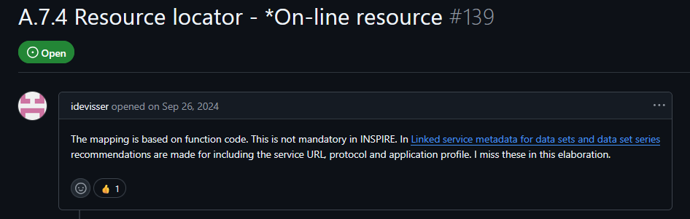
Geo-DCAT-AP #139
A.7.4 Resource locator - *On-line resource
Proposal to base the mapping based on the service URL, protocol and application profile (Data-service-linking simplification fields), instead of
Current ISO-to-GeoDCAT-AP mapping - based on CI_OnlineFunctionCode.
https://github.com/SEMICeu/GeoDCAT-AP/issues/139

Slide 4
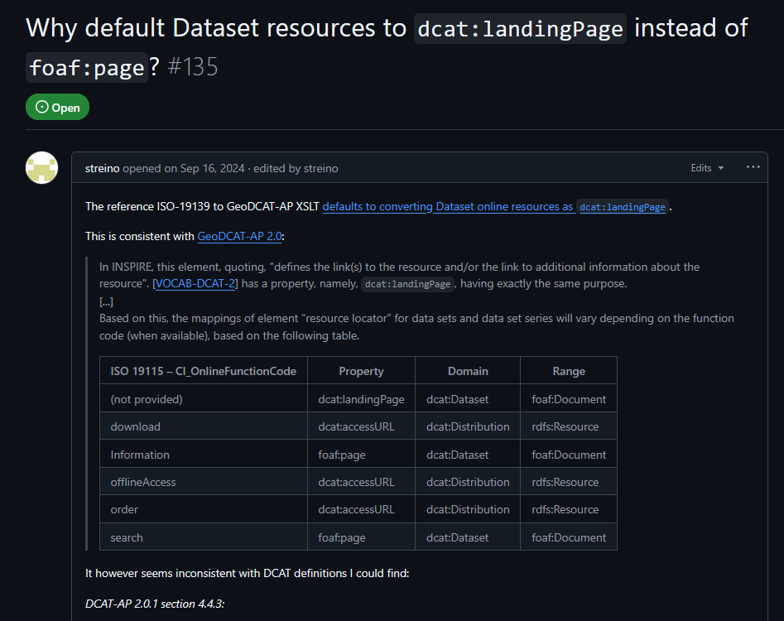
Pilot #9
Transformation: Distribution, LandingPage and Documentation
Currently, only resources that have capabilities and/or are defined as “download” are mapped to distributions (and potentially linked services).
Related to Geo-DCAT-AP #139.
https://github.com/INSPIRE-MIF/GeoDCAT-AP-pilot/issues/9

Slide 5
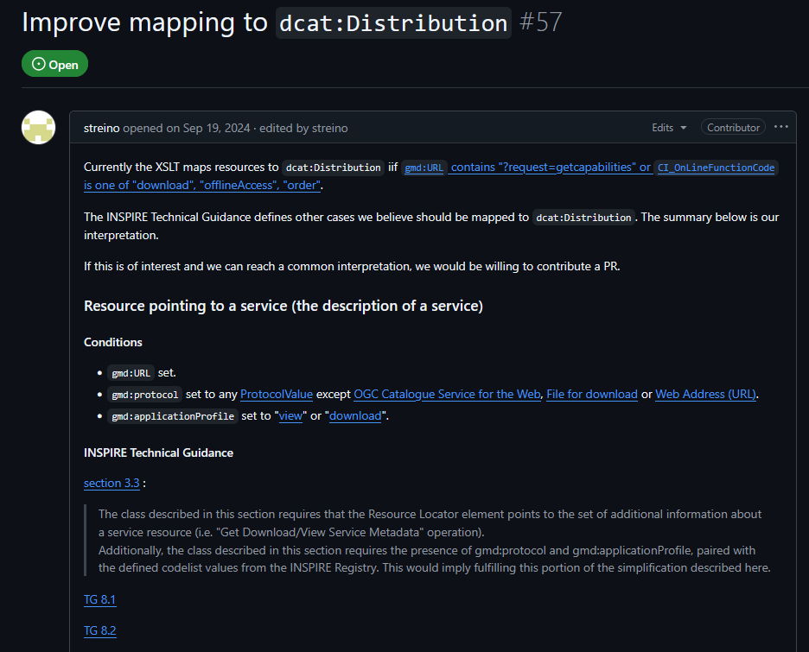
XSLT #57
Improve mapping to dcat:Distribution
Related to Geo-DCAT-AP #139.
https://github.com/SEMICeu/iso-19139-to-dcat-ap/issues/57

Slide 6
Geo-DCAT-AP #135
Why default Dataset resources to dcat:landingPage instead of foaf:page?
Related to Geo-DCAT-AP #139.
https://github.com/SEMICeu/GeoDCAT-AP/issues/135

Slide 7
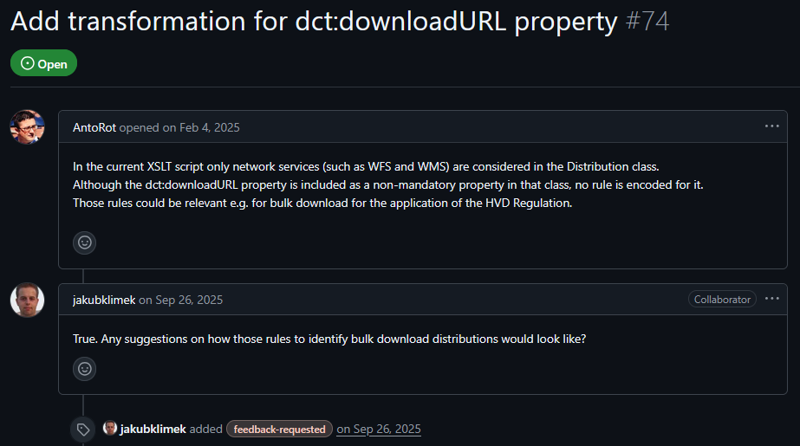
XSLT #74
Add transformation for dct:downloadURL property
Related to Geo-DCAT-AP #139.
‘Bulk download’ option between the cases difficult to filter in ISO 19115 metadata.
https://github.com/SEMICeu/iso-19139-to-dcat-ap/issues/74

Slide 8
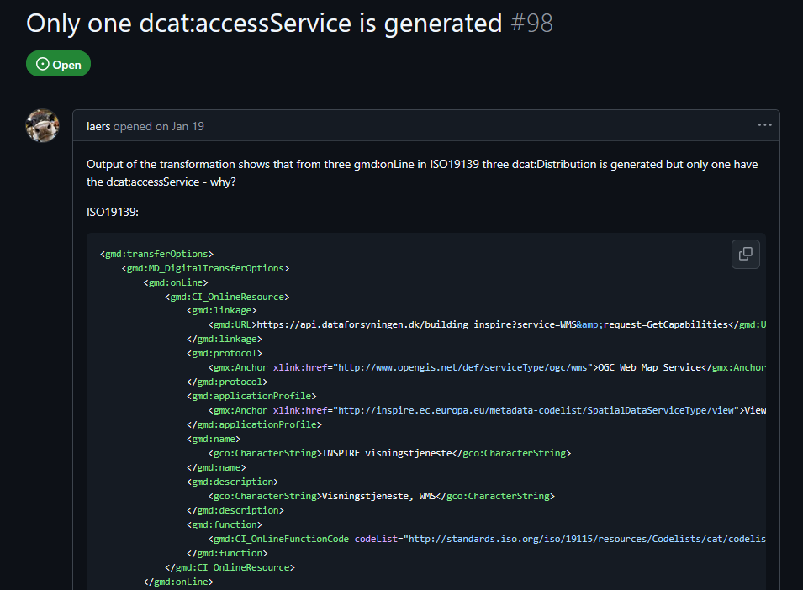
XSLT #98
Only one dcat:accessService is generated
Granularity inside the Digital Transfer Options affects the output in GeoDCAT-AP.
Related to Geo-DCAT-AP #139.
Agree on mapping first.
https://github.com/SEMICeu/iso-19139-to-dcat-ap/issues/98

Slide 9
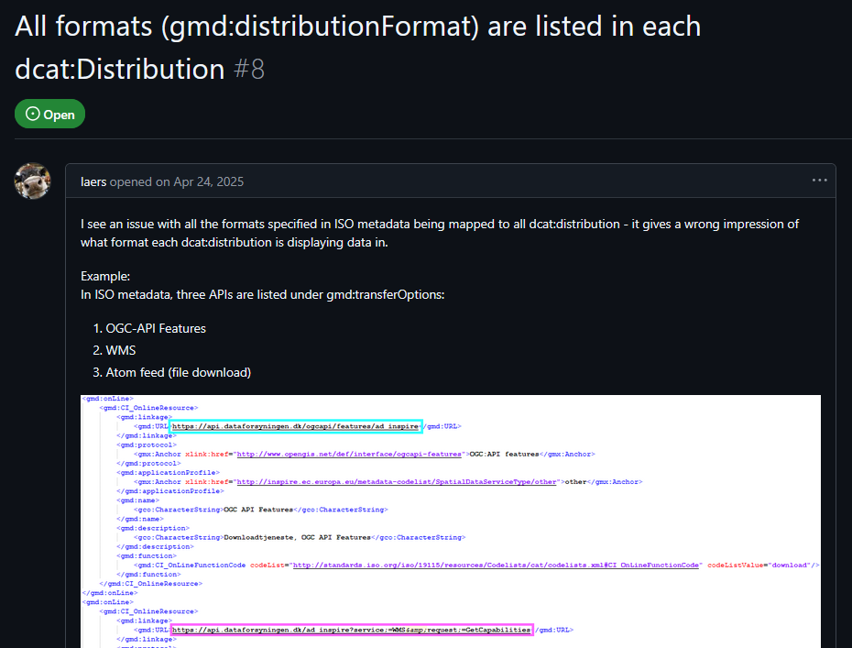
Pilot #8
All formats (gmd:distributionFormat) are listed in each dcat:Distribution
Formats in ISO 19115 metadata are unlinked from service distributions.
Indirectly related to Geo-DCAT-AP #139.
https://github.com/INSPIRE-MIF/GeoDCAT-AP-pilot/issues/8

Slide 10
Pilot #3 / GeoDCAT-AP #147 / Pilot #7
Proposal to add hvdCategory as optional to GeoDCAT-AP 3.0
https://github.com/INSPIRE-MIF/GeoDCAT-AP-pilot/issues/3
Add 'HVD category' and 'documentation' properties related to high-value datasets
https://github.com/SEMICeu/GeoDCAT-AP/issues/147
Transformation: HVD Category
https://github.com/INSPIRE-MIF/GeoDCAT-AP-pilot/issues/7
Three issues related to the implementation of the geospatial HVD tagging good practice, now implemented in the SEMIC XSLT.
The three proposed now to be closed.
Any further aspects to be considered regarding keyword transformation and HVD categories assigned in GeoDCAT-AP?

Slide 11
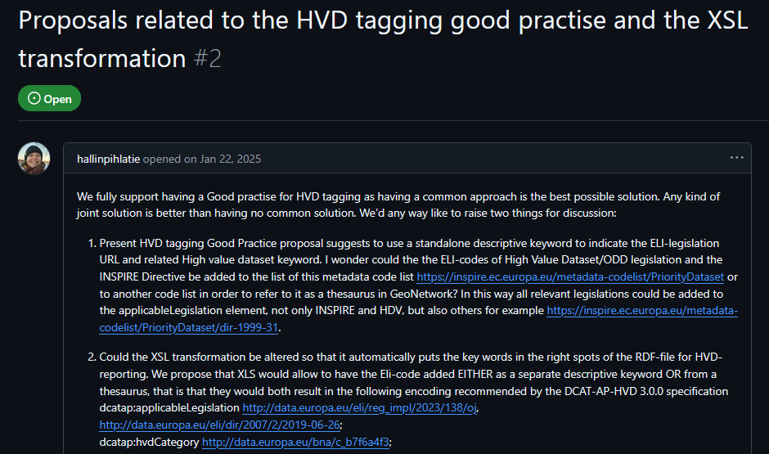
Pilot #2
Proposals related to the HVD tagging good practice and the XSL transformation
Proposals discussed and clarified.
Now the SEMIC XSLT implements the geospatial HVD tagging good practice.
Pending to discuss by the community how to refer in GeoDCAT-AP to other legislations different from the ELI-codes of High Value Dataset/ODD legislation, such as the ones from the Priority Datasets code list.
https://github.com/INSPIRE-MIF/GeoDCAT-AP-pilot/issues/2

Slide 12
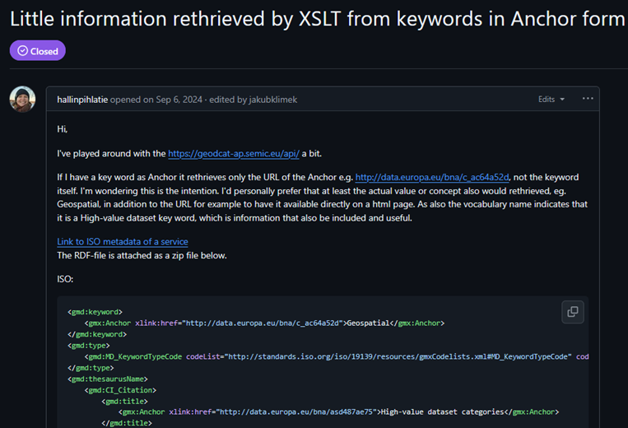
GeoDCAT-AP #134
Little information retrieved by XSLT from keywords in Anchor form
Related to Pilot #2.
Closed in October 2024, waiting for a common approach on geospatial HVD tagging
Should it be now revisited?
https://github.com/SEMICeu/GeoDCAT-AP/issues/134

Slide 13
Less prioritised issues

Slide 14
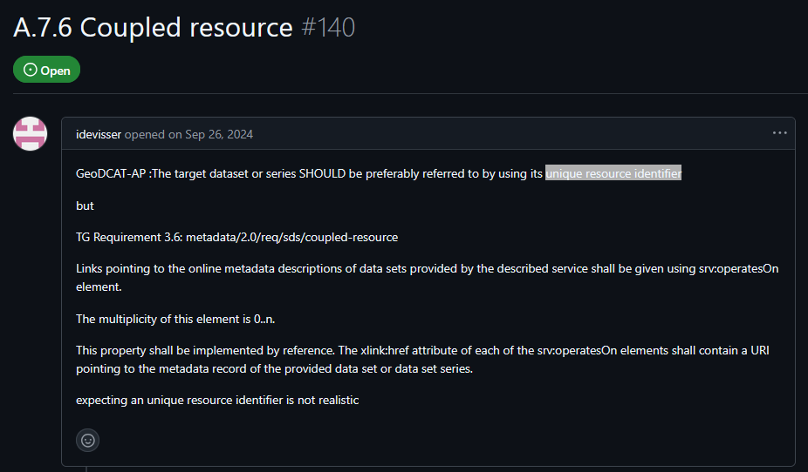
GeoDCAT-AP #140
A.7.6 Coupled resource
INSPIRE indirectly points the dataset (or dataset series), though the corresponding metadata.
Not exactly the unique resource identifier of the dataset (or series).
Not really an issue.
Proposed to be resolved adding a usage note.
https://github.com/SEMICeu/GeoDCAT-AP/issues/140

Slide 15
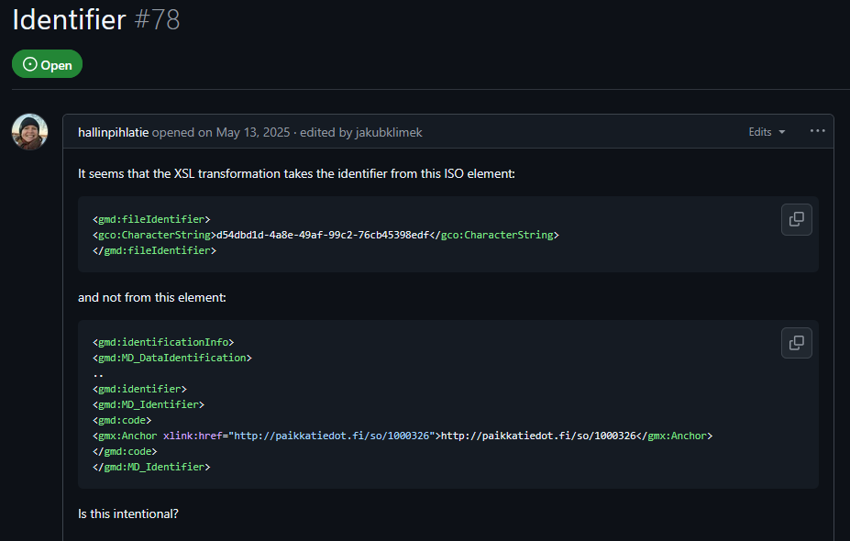
XSLT #78
Identifier
‘parentIdentifier’ ISO metadata field currently not mapped to DCAT-AP / GeoDCAT-AP – Mapping alternatives:
dcterms:isPartOf
dcat:inSeries (dcterms:isPartOf sub-property in DCAT 3)
any other?
Note: ‘gmx:Anchor’ encodings seem neither be considered in the XSLT (nor in the ISO-to-GeoDCAT-AP mapping).
Priority topic deserving a separated discussion thread.
https://github.com/SEMICeu/iso-19139-to-dcat-ap/issues/78

Slide 16
Not discussed (for next meeting)

Slide 17
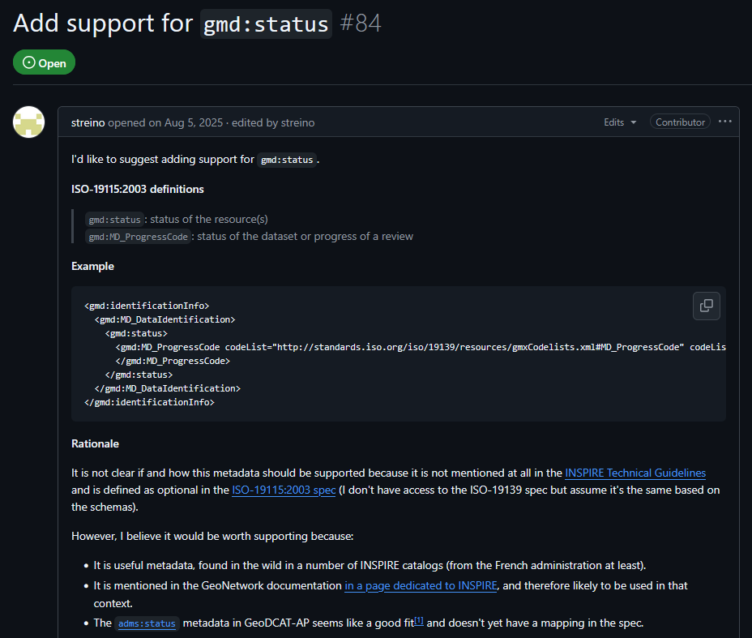
XSLT #84
Add support for gmd:status
‘gmd:status’ ISO metadata field currently not mapped to DCAT-AP / GeoDCAT-AP – Mapping alternatives:
adms:status
Community discussion required.
Some pre-discussions would be needed.
https://github.com/SEMICeu/iso-19139-to-dcat-ap/issues/84

Slide 18
XSLT #64
Multiple geometry serialisations for dcat:bbox
The current transformation of ISO geospatial extent as both, locn:geometry and dcat:bbox attributes of locations, should be revisited and only kept the latter.
Whereby the geometries are serialised in various datatypes, there was no specific preference on which serialisation to use if only a single type is to be maintained.
European data portal geoharvester uses a single datatype (technical choice). It only exposes the coordinates available in the ISO metadata.
https://github.com/SEMICeu/iso-19139-to-dcat-ap/issues/64

Slide 19
Pilot #11
Have you faced issues when transforming service and multilingual metadata?
Feedback requested on issues detected when transforming multilingual datasets, depending on the use of the core or extended profile.
https://github.com/INSPIRE-MIF/GeoDCAT-AP-pilot/issues/11

Slide 20
XSLT #71
More than one dataset identifier
Multiple dataset identifiers are also possible in GeoDCAT-AP (cardinality 0..*).
User asked to provide input examples in ISO 19115.
https://github.com/SEMICeu/iso-19139-to-dcat-ap/issues/71

Slide 21
XSLT #72
Duplicity of schema:startDate/schema:endDate after transformation
Note: once as schema:startDate and once as dcat:startDate.
SEMIC to explain: This fact derives from a change from DCAT 1 to DCAT 2.
A user suggested to remove the DCAT 1 schema:startDate / schema: endDate version.
Feedback is requested by the community.
https://github.com/SEMICeu/iso-19139-to-dcat-ap/issues/72

Slide 22
GeoDCAT-AP #171
"OGC EPSG Coordinate Reference Systems Register" too narrow?
https://github.com/SEMICeu/GeoDCAT-AP/issues/171

